Slide 1
Pathway profiles differ between low vs high sis3 score group; suggests potential mechanism
Pathway profiles differ across time-since-stroke group for low sis3 patients; suggests potential intervention time and strategy
Pathway profiles differ across similar sis3 scores
Longitudinal test is useful for validating pattern that early pathway profiles is associated with sis3 score in later window

Slide 2
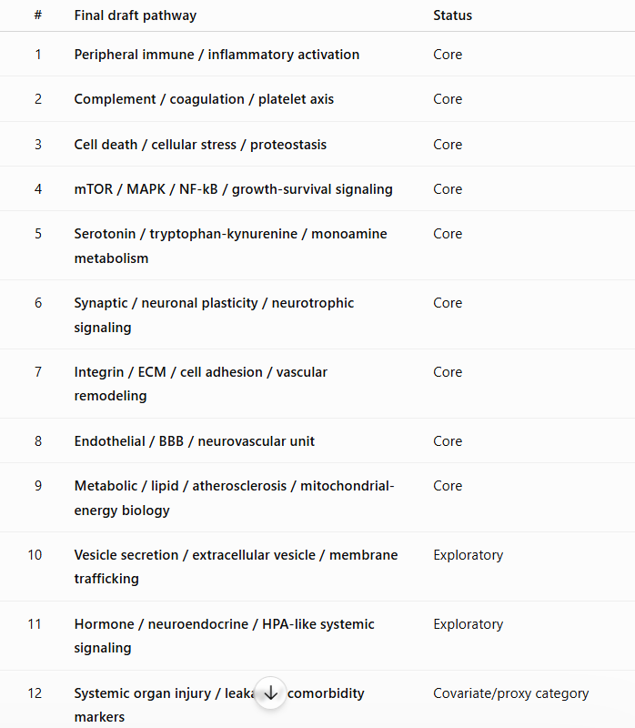
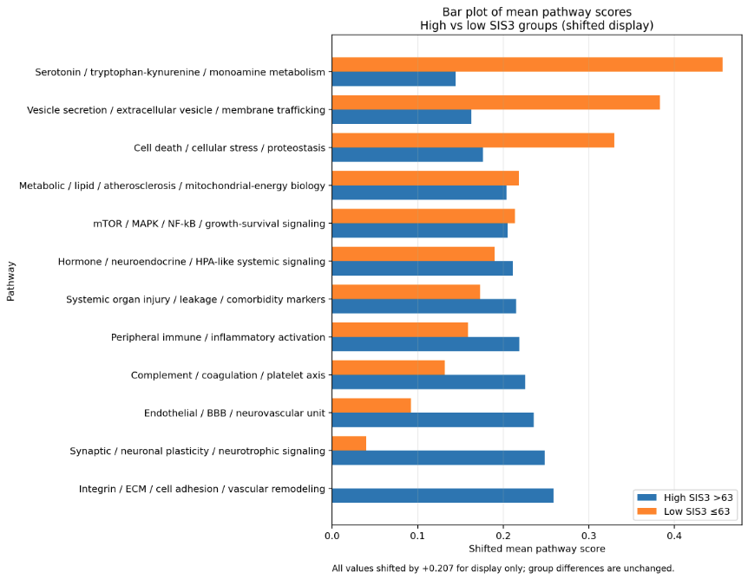
Pathway profiles differ between low vs high sis3 score group; suggests potential mechanism

Slide 3
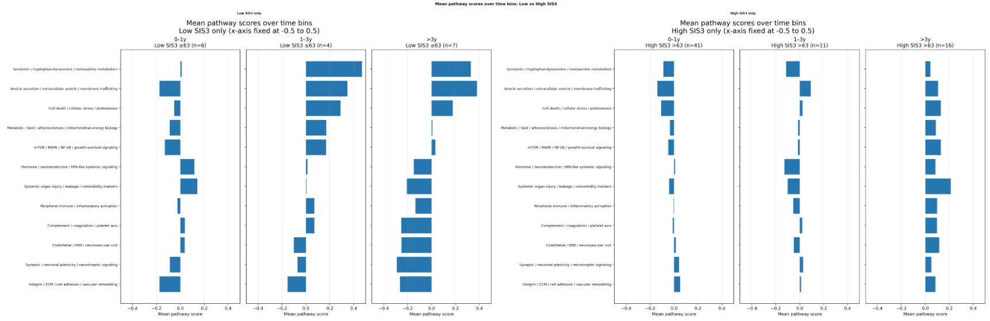
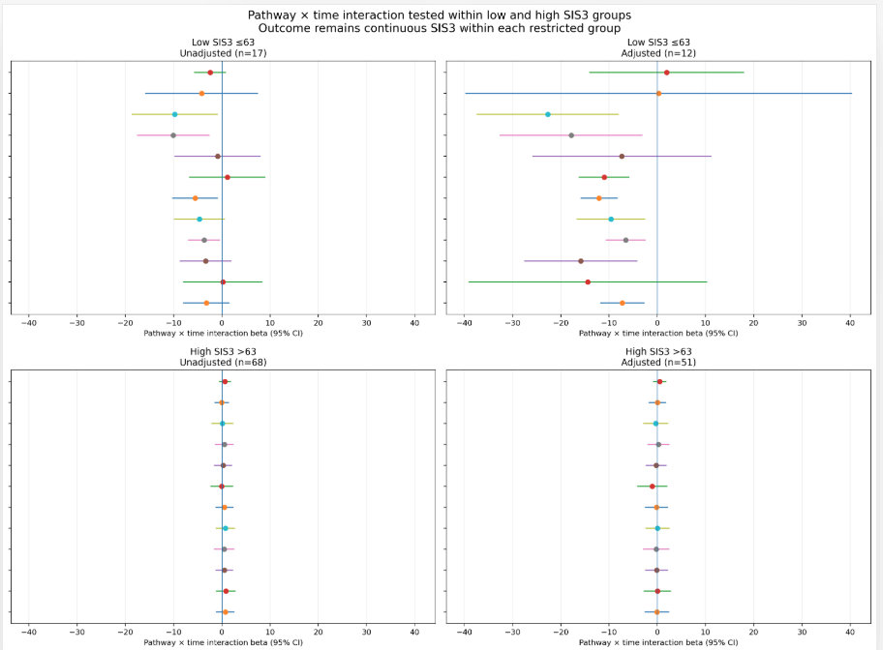
Pathway profiles differ across time-since-stroke group for low sis3 patients; suggests potential intervention time and strategy

Slide 4
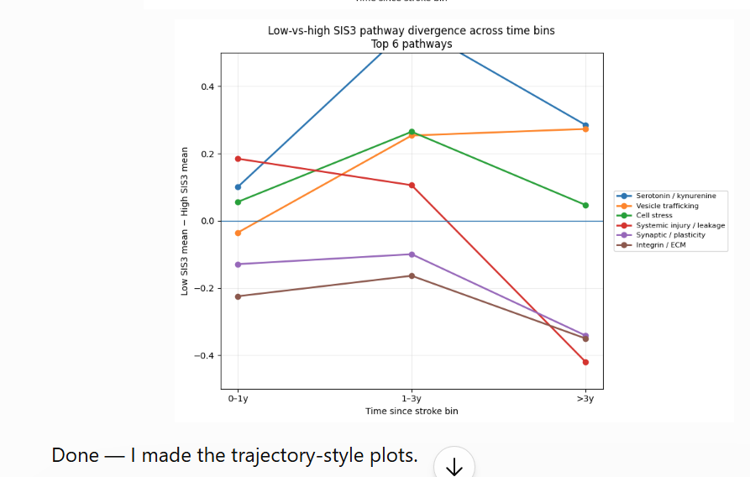
Pathway profiles differ across time-since-stroke group

Slide 5
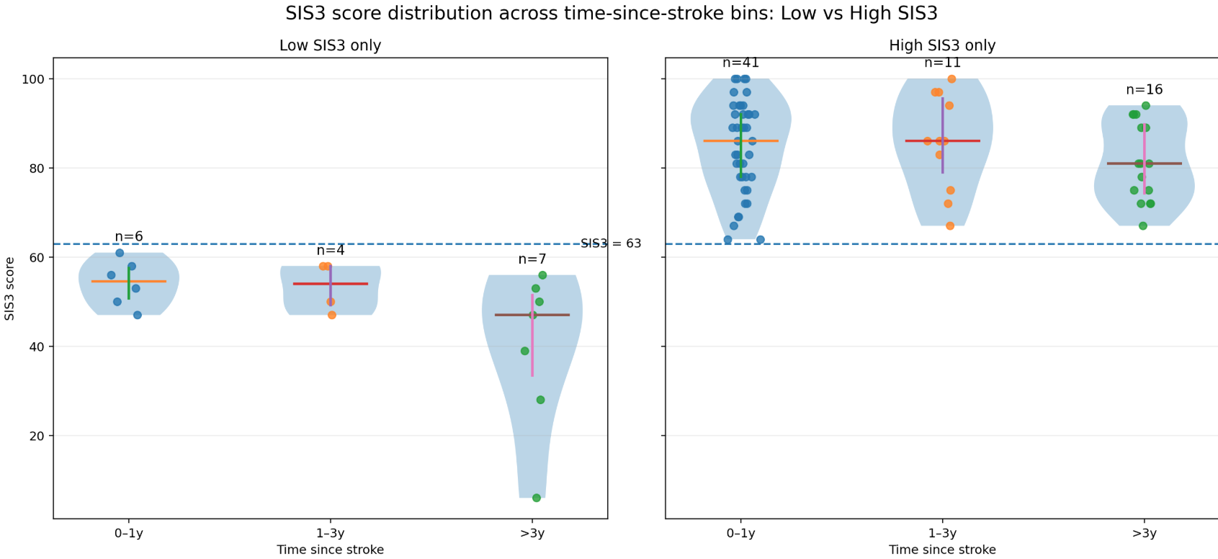
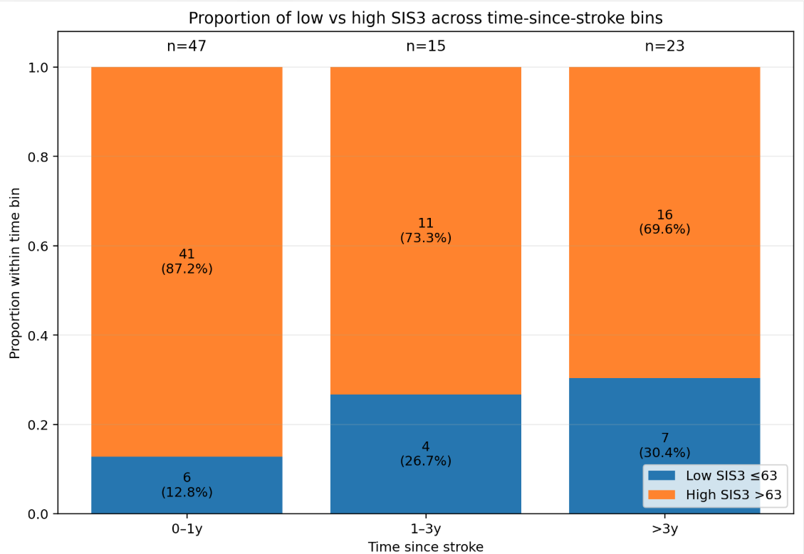
Sis3 score distribution in time-since-stroke

Slide 6
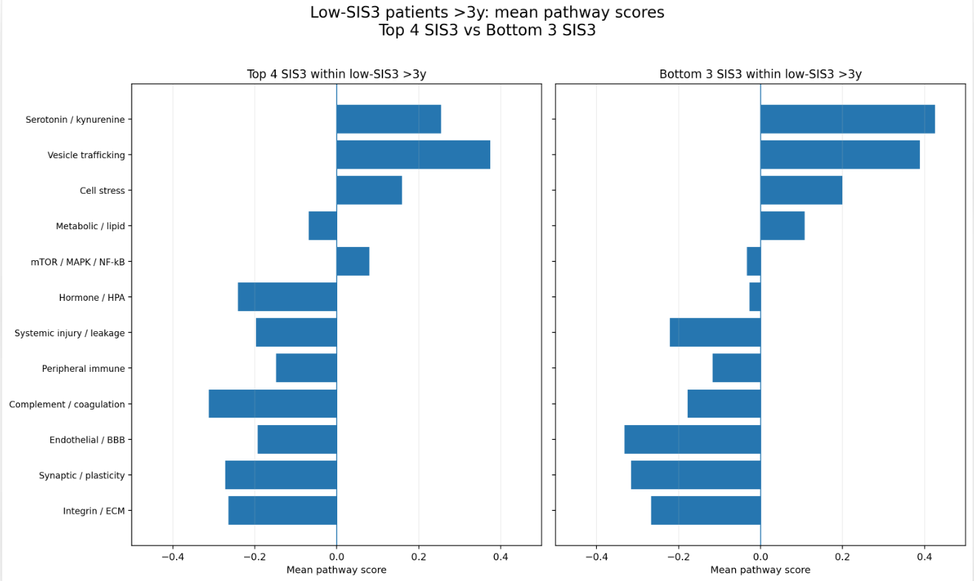
Pathway profiles differ across similar sis3 scores

Slide 7
Longitudinal test is useful for validating pattern that early pathway profiles is associated with sis3 score in later window

